Slide 1
SCRUM EVENTS AND ARTIFACTS

Slide 2
FINAL
50 Multiple Choice and True False
Covering all slides, class room discussions, assignments
Topics Covered Include
Agile Estimation
Agile Product Management (portfolio and team and backlog)
Agile Values and Princples
Kanban
Lean Startup
SAFe
Scrum, Scrum Roles, Events, Pillars, Values

Slide 3
Objectives:
After the class, you should be able to:
Identify the 3 Main Scrum Artifacts
Participate in the following meetings effectively:
Sprint Planning Meeting
Daily Stand Up
Sprint Review/Demo
Sprint Retrospective
Backlog Refinement

Slide 4
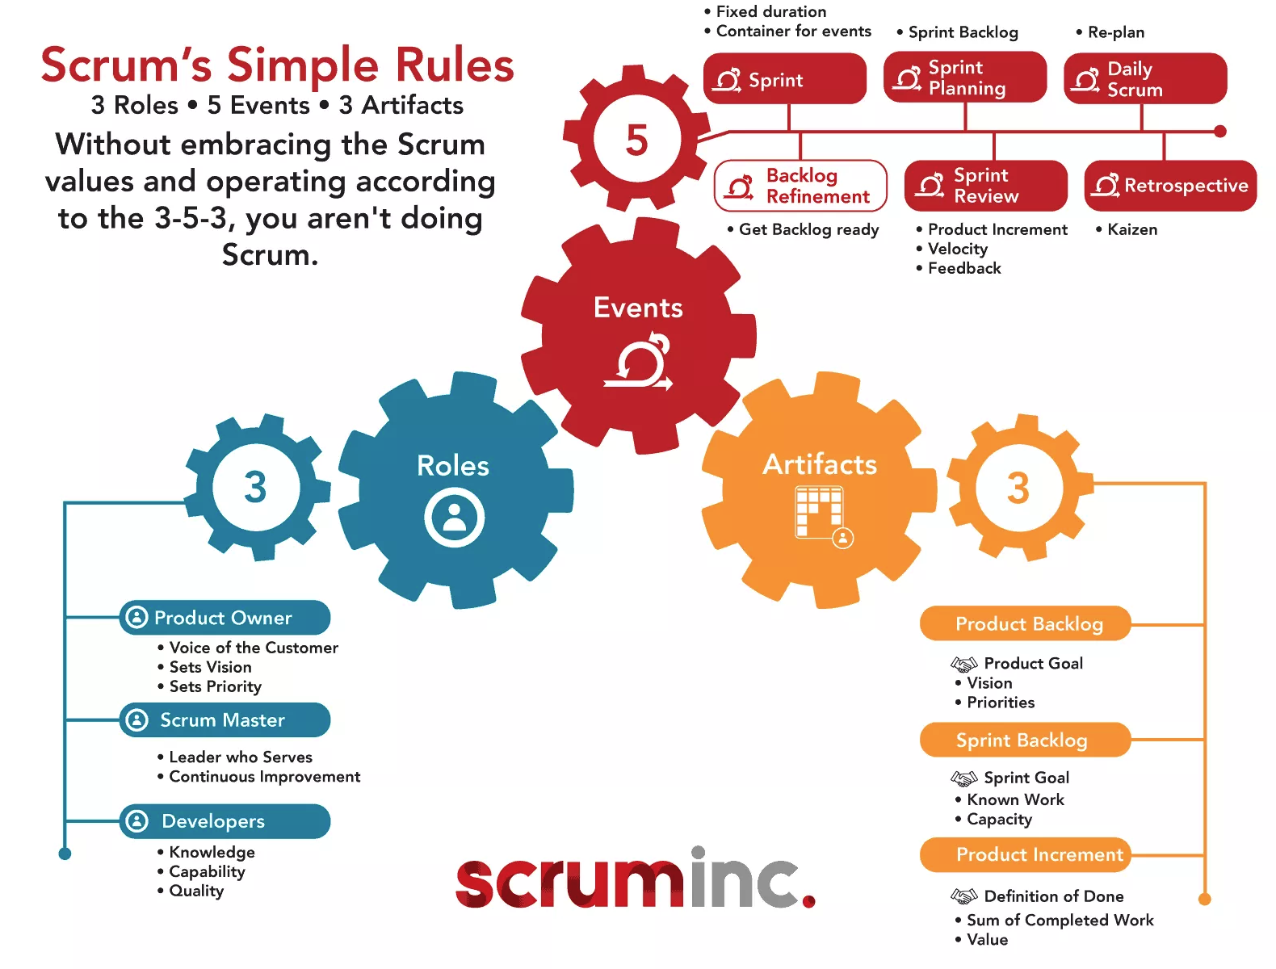
Elements of Scrum

Slide 5

3 Scrum Roles
Product Owner
Represents the customer
Scrum Master
Facilitates the process
Development Team
Builds the software
Notes:
Potentially many responsibilities and different skills on an agile team, but only four specific roles.
No team lead, business analyst, technical liaison, feature point estimator, operational project manager, etc.

Slide 6

3 Sprint Artifacts
Product Backlog
All known requests
Initiatives
Features
User Stories
Sprint Backlog
Requests being worked on in current sprint
Subset of the full User Story Backlog
Increment
Advancement of the Product at the end of the sprint
Potentially shippable code

Slide 7

5 Scrum Events
Sprint:
A time box for development
Usually 2 – 4 Weeks in length
4 Scrum Events:
Sprint Planning
Daily Stand Up
Sprint Review / Demo
Sprint Retrospective
Scrum guide list 5 events
The Sprint
Sprint Planning
Daily Scrum
Sprint Review
Sprint Retrospective
Most Scrum teams will also include a 6th Event
Backlog Refinement

Slide 8
Scrum Events
SCRUM EVENT TITLE
Using a flip chart, work with your team and reference the Scrum Guide to complete the following description of the SCRUM event you table is assigned.
Next we will do a gallery tour to fine tune each event.
Purpose
Inputs
Outputs
Who Needs to Attend

Slide 9
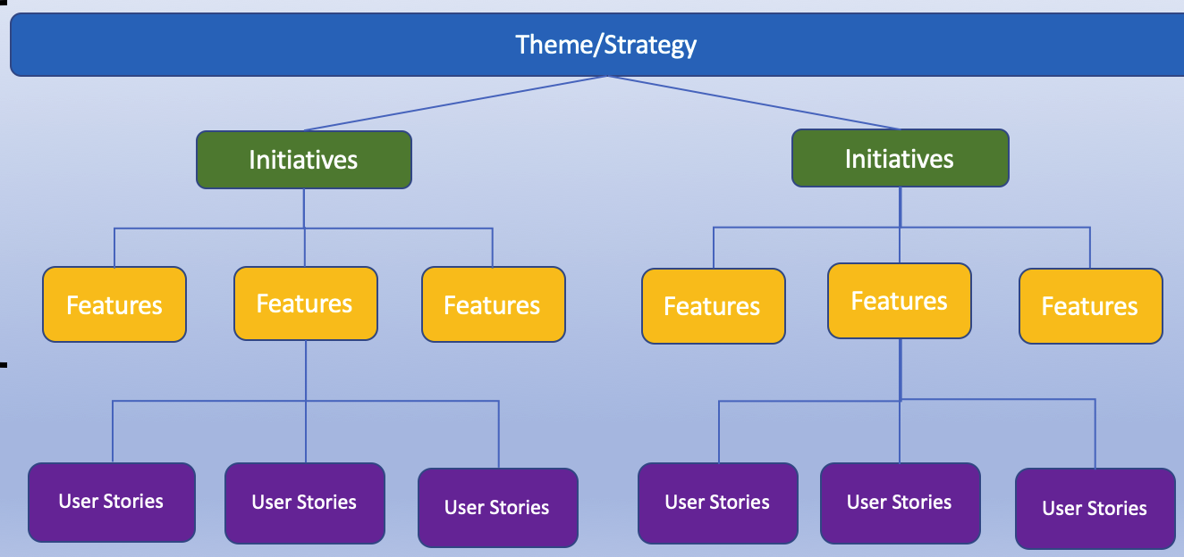
Sprint Goal
High level statement about what product features the team will work build into the product
Helps the team focus
Allows the PO and team to adjust stories as necessary
Makes it easier for stakeholders to understand what the team is doing
THINK FEATURES

Slide 10

Sprint Planning
Purpose: Plan the work of the next Sprint
Attendees: Scrum Team
Steps:
Review / Create Sprint Goal
Review selected Stories as a group
Collaborate on order of stories
Sign up for work
Task out the selected stories
Load balance if necessary
Consensus Check

Slide 11
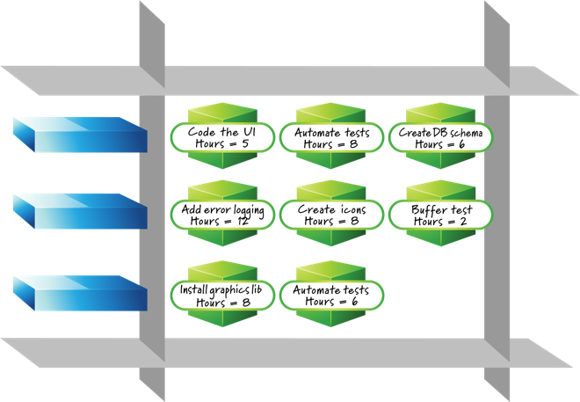
Sprint Planning
Team should leave meeting with:
Value prioritized list of stories
Detailed plan for accomplishing the work
Expressed as tasks
Belief that all the work can be completed
Without working extra hours

Slide 12

After the Sprint Planning Meeting
Scrum assumes that the goal(s) for the sprint are “locked” or “sealed” after the planning meeting
Individual stories may change as the team and product owner negotiate scope
Sprint is canceled if goal(s) change
A new sprint planning meeting is initiated
In practice, it is rarely a good idea to cancel a sprint
Incredibly wasteful

Slide 13
New stories entering the sprint
Sealing the sprint is often difficult initially
Stakeholders have back channel access
Developers want to be helpful
Team lacks a sense of collective ownership for the Sprint goal & backlog
New stories lower the team’s performance
Require extra effort for the team to understand the request and define tasks
Team loses focus
TEAM DERIVED USER STORIES DO NOT IMPACT PERFORMANCE
Team may discover necessary work to achieve goal. That freedom is necessary to deliver sprint goal.

Slide 14
Adopt a Zero Sum Approach
Individual and Team capacity is always a zero sum game.
Each new request reduces the capacity of the team to complete a planned item
If something is added, items of equal value must always be removed
Only if team agrees with the swap

Slide 15

Daily SCRUM
Purpose: Keep the team in synch
Attendees: Scrum Team but this essentially for development team members
Rules:
15 min time box
Everyone stands (if co-located)
Same time & place every day
Everyone answers the 3 questions

Slide 16
Daily Stand Up
The daily stand up is team’s most important tool for staying focused on the Sprint’s goals and backlog
It is not a status meeting! It is a coordination meeting!
Team members should evaluate each other’s report during the meeting
How does each person’s work yesterday and today impact our goals?
Collective responsibility – not just Scrum Master
What did I do yesterday that helped the Development Team meet the Sprint Goal?
What will I do today to help the Development Team meet the Sprint Goal?
Do I see any impediment that prevents me or the Development Team from meeting the Sprint Goal?

Slide 17

Sprint Review
The Scrum Team and stakeholders collaborate about what was done in the Sprint.
Based on that and any changes to the Product Backlog during the Sprint, attendees collaborate on the next things that could be done to optimize value.
This is an informal meeting, not a status meeting, and the presentation of the Increment is intended to elicit feedback and foster collaboration.
Attendees: Scrum Team & Stakeholders
Steps:
Review with attendees:
Sprint Goals
Sprint Highlights
Stories Completed
Development Team demonstrate completed stories
Discuss with Stakeholders goals for next Sprint, get confirmation to proceed

Slide 18
Sprint Review
Replaces traditional status reporting meeting
Team should publish results someplace accessible to interested stakeholders
Address any status reporting issues required by various management groups
Anyone who needs update should attend meeting
Stakeholders & Customers
Project management
IT & Product Management

Slide 19

Sprint Retrospective
Purpose: To continually improve
Attendees: Scrum Team
Team discusses:
What worked well during the last Sprint?
What didn’t work or was confusing?
What should we try to improve in the next Sprint?

Slide 20
Sprint Retrospective
There are many useful formats
Mix it up occasionally
Make sure everyone is involved
Use metrics to sponsor discussion
Did our velocity or quality numbers improve or get worse?
Is the release progressing as planned?
Gather good and analyze bad
Proactively search for improvements so you repeat them
Determine root cause when items go wrong
It’s not just about “process”

Slide 21

Backlog Refinement (unofficial event)
Meeting for the Product Owner to gather critical feedback from the Development Team members about the Product Backlog
Key Activities:
Discuss new or modified User Stories on the backlog, and request Development Team to provide an estimate (story points)
Review the upcoming Sprint Goal, and confirm with the team the User Stories intended to support that goal and understand any outstanding information needed for the team to begin work on those User Stories in the next sprint

Slide 22
Backlog Refinement Sessions
Teams typically have a standard cadence for grooming the backlog
Often 1 meeting per sprint
In a 2 week sprint, commonly alternates with Sprint Planning meeting
Same day, every other week
This only time work not in the sprint is discussed

Slide 23
Class Exercise
Scrum Events: What would the calendar look like for members of a Scrum team?
Fill in the calendar with the Scrum Event, Length of Time, and Occurances
Day | Day | Day | Day | Day
Week 1
Week 2
Backlog Refinement
Daily Scrum
Sprint Retrospective
Sprint Review
Sprint Planning

Slide 24
Time boxing
Scrum theorizes that human activity will always grow to match the time allotted
Setting strict time limits focuses attention and improves output
Recommended Time boxes:
Sprint Length | Sprint Planning | Daily Scrum | Backlog Refinement | Review | Retrospective
2 weeks | 4 hrs | 15min | 1 hr | 1 hr | 1 hr
3 weeks | 6 hrs | 15min | 1.5 hrs | 1.5 hr | 1.5 hr
Notes:
Sprint Planning 2wks: 2-4 hrs

Slide 25
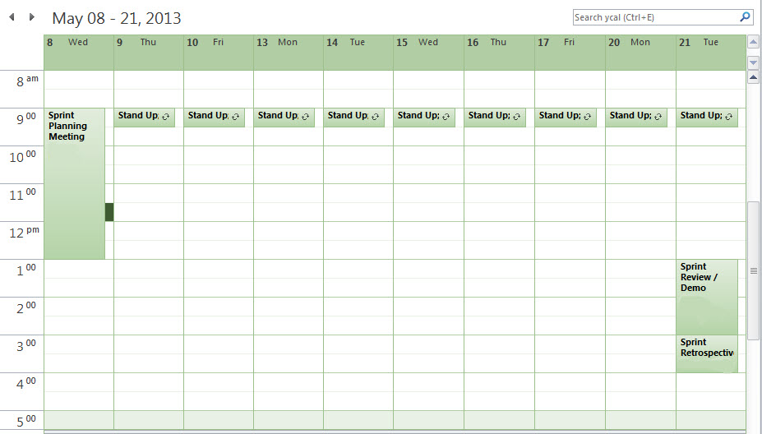
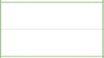
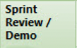
Standard Scrum Calendar
Backlog Refinement
Teams use the same schedule repeatedly.
Improves Predictability & Scheduling.

Slide 26
COMMON METRIC - Sprint Burn Down Chart
Shows total number of hours or points in sprint
Decremented each day as work is accomplished
“Burns down” to 0 by end of Sprint
Goal Pace of Completing Work Remaining on a Daily Average
Team is AHEAD of Goal Pace
Team is BEHIND the Goal Pace
HOURS OF TASK WORK REMAINING

Slide 27
Sprint Burn Down Chart
Reviewed by the team at each stand up
Helps the team identify if they are on track to deliver as expected
Provides transparency to anyone interested in how the sprint is progressing

Slide 28
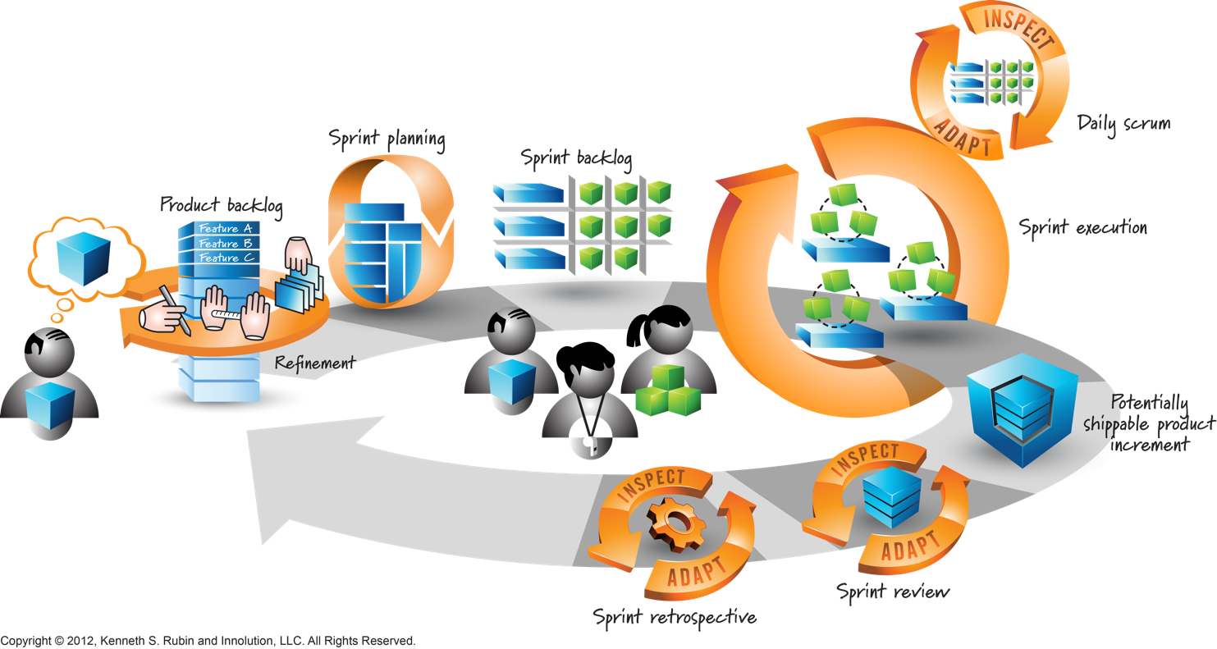
Scrum Events: Execute, Inspect, Adapt cycle

Slide 29
Next Up…. Lego Serous Play Scaled Agile Final Preparation
Purchase LEGO SERIOUS PLAY FROM BOOKSTORE ON TUESDAY <$7
DO NOT OPEN THE KITS!!!!!!!

Slide 30
Have a great & healthy week
and remember…
Think Lean,
Be
Agile!

